Slide 1
Introduction to Pharmacodynamics Novartis-Academia Hackathon
Pharmacometrics
Andrew Stein, PhD
Associate Director Pharmacometrics
Cambridge, MA August 2019

Slide 2
Overview
Target Audience: people with a quantitative background that are new to pharmacometrics.
Simple differential equations will be used
Topics covered
Key mathematical results for pharmacodynamic models
Introduction and motivation for the Emax model
Introduction to immediate and delayed effect PKPD models

Slide 3
Acknowledgements (Based on material from)
Rowland, M., Tozer, T. N. Clinical pharmacokinetics and pharmacodynamics: concepts and applications
Peter Bonate, Astellas
Richard Brundage, U Minnesota
Leon Aarons, U Manchester
Jean-Louis Steimer, Novartis
Martin Fink, Novartis
Nick Holford, U Auckland http://holford.fmhs.auckland.ac.nz/Teaching/pharmacometrics/advanced.php

Slide 4
Pharmacodynamics
What the drug does to the body

Slide 5
The “PKPD” pathway of drug effect
Absorbed by intestines into blood
Distribute from blood into tissue
Binds target in tissue
Effects
Oral Dose
Drug Concentration
Measurement
Elimination
from body
Pharmacokinetics (PK):
How body affects drug
Pharmacodynamics (PD):
How drug affects body
What does is needed to shrink a tumor without causing severe neutropenia
Should children and adults receive the same dose?

Slide 6
Main targets for drugs
Receptors
Enzymes
Signal Transduction
Ion Channels
Soluble agents
Cytokines

Slide 7
Cell
wikipedia

Slide 8
Receptor – Signal Transduction
Binding
Conformation
Change
Signaling
Ligand
Receptor

Slide 9
Drug can block binding and inhibit signaling (antagonist)
Binding
Conformation
Change
Signaling
Ligand
Drug 2
Drug 1
Receptor

Slide 10
Drug can enhance signaling (agonist)
Binding
Conformation
Change
Signaling
Drug
Receptor

Slide 11
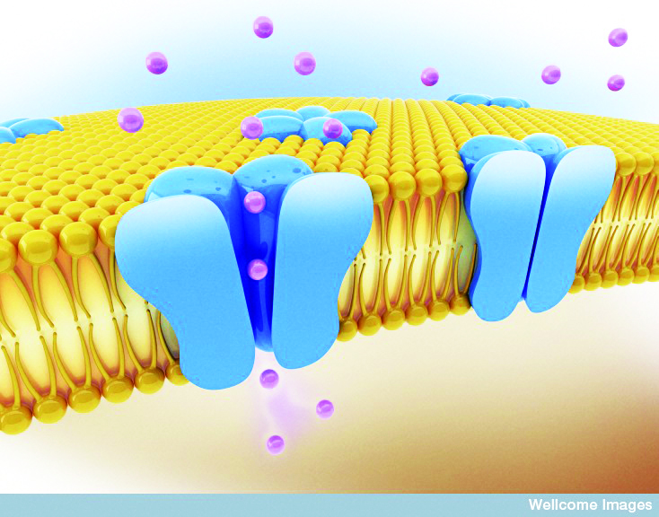
Receptor - Ion channel
Cell membrane receptors allow the outside of the cell to communicate with the inside of the cell
From Peter Bonate

Slide 12
Drug can keep an ion channel open or closed
From Peter Bonate

Slide 13
Enzyme kinetics
Substrate
Products
Enzyme
Complex
Enzyme

Slide 14
Drug interference with enzyme
Substrate
Products
Enzyme
Complex
Enzyme

Slide 15
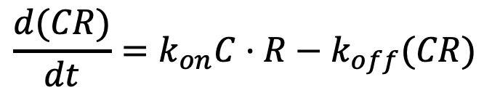
Classical Binding Theory
Drug
(C)
+
Target
(R)
k_{off}
k_{on}
Complex
(CR)
$$\frac{d(CR)}{dt}=k_{on}C·R−k_{off}(CR)$$

Slide 16
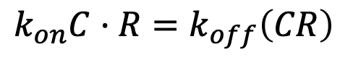
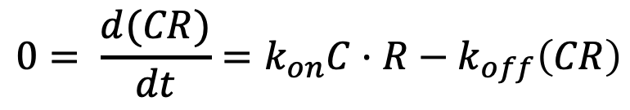
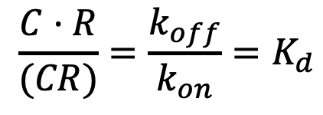
The dissociation constant gives the equilibrium drug concentration
Drug
(C)
+
Target
(R)
k_{on}
k_{off}
Complex
(CR)
$$0= \frac{d(CR)}{dt}=k_{on}C·R−k_{off}\left(CR\right)$$
$$k_{on}C·R=k_{off}\left(CR\right)$$
$$\frac{C·R}{(CR)}=\frac{k_{off}}{k_{on}}=K_{d}$$
dissociation constant
The dissociation constant tells you how tightly the drug binds

Slide 17
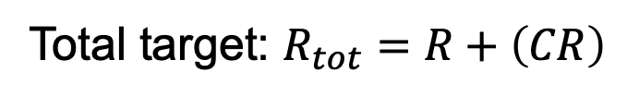
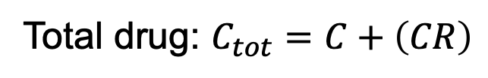
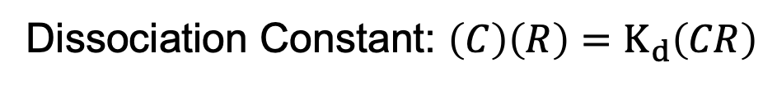
We want a formula for what fraction of the target is free.
Drug
(C)
+
Target
(R)
k_{on}
k_{off}
Complex
(CR)
Total drug: $C_{tot}=C+\left(CR\right)$
Total target: $R_{tot}=R+\left(CR\right)$
Dissociation Constant: $\left(C\right)\left(R\right)=K_{d}\left(CR\right)$
Given a starting drug concentration,
what is percent of free target: R/R_{tot}?

Slide 18
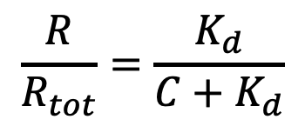
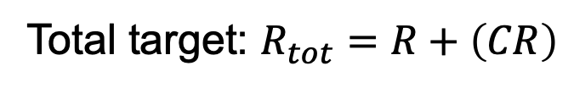
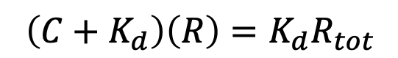
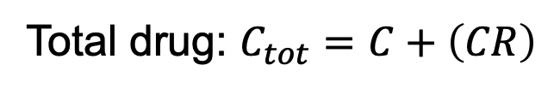
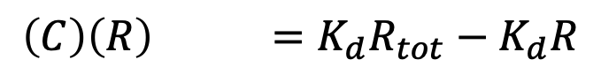
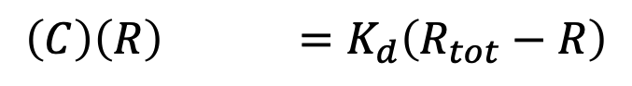
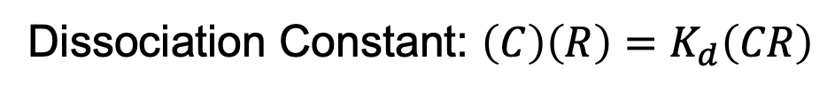
Solving for free target
Total drug: $C_{tot}=C+\left(CR\right)$
Total target: $R_{tot}=R+\left(CR\right)$
Dissociation Constant: $\left(C\right)\left(R\right)=K_{d}\left(CR\right)$
$$\left(C\right)\left(R\right) =K_{d}\left(R_{tot}−R\right)$$
$$\left(C\right)\left(R\right) =K_{d}R_{tot}−K_{d}R$$
$$\left(C+K_{d}\right)\left(R\right)=K_{d}R_{tot}$$
$$\frac{R}{R_{tot}}=\frac{K_{d}}{C+K_{d}}$$

Slide 19
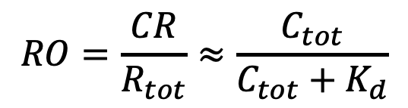
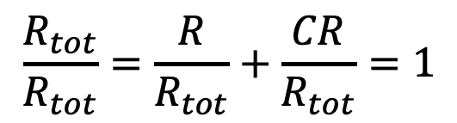
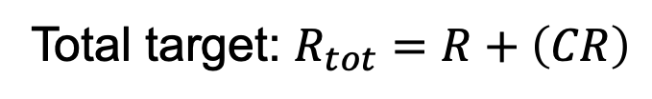
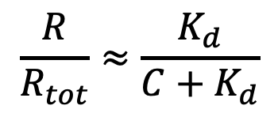
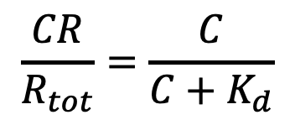
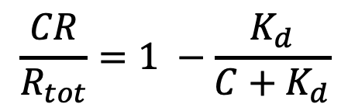
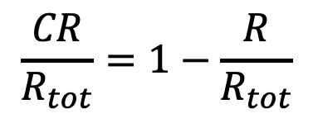
Solving for target occupancy
$$\frac{R}{R_{tot}}≈\frac{K_{d}}{C+K_{d}}$$
Total target: $R_{tot}=R+\left(CR\right)$
$$\frac{R_{tot}}{R_{tot}}=\frac{R}{R_{tot}}+\frac{CR}{R_{tot}}=1$$
$$\frac{CR}{R_{tot}}=1−\frac{R}{R_{tot}}$$
$$\frac{CR}{R_{tot}}=1 −\frac{K_{d}}{C+K_{d}}$$
If target is a receptor, this is called receptor occupancy (RO)
$$\frac{CR}{R_{tot}}=\frac{C}{C+K_{d}}$$
$$RO=\frac{CR}{R_{tot}}≈\frac{C_{tot}}{C_{tot}+K_{d}}$$
When R_{tot} >> K_{d}

Slide 20
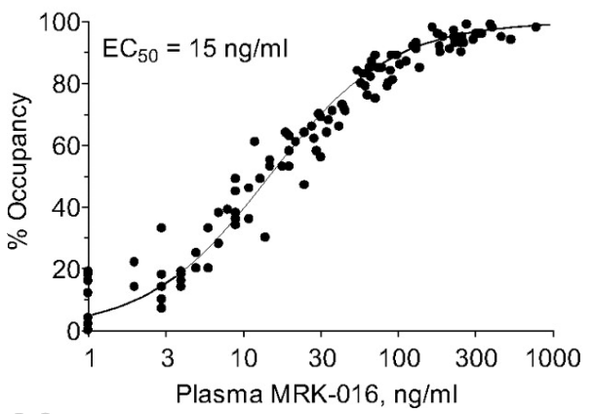
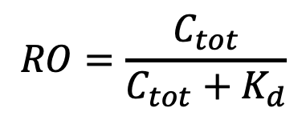
Receptor occupancy data
$$RO=\frac{C_{tot}}{C_{tot}+K_{d}}$$
50
K_{d} = 15 ng/ml (≈ 40 nM)
where 50% is bound
15
Atack, John R., et al. "In vitro and in vivo properties of 3-tert-butyl-7-(5-methylisoxazol-3-yl)-2-(1-methyl-1H-1, 2, 4-triazol-5-ylmethoxy)-pyrazolo [1, 5-d]-[1, 2, 4] triazine (MRK-016), a GABAA receptor α5 subtype-selective inverse agonist." Journal of Pharmacology and Experimental Therapeutics 331.2 (2009): 470-484.

Slide 21
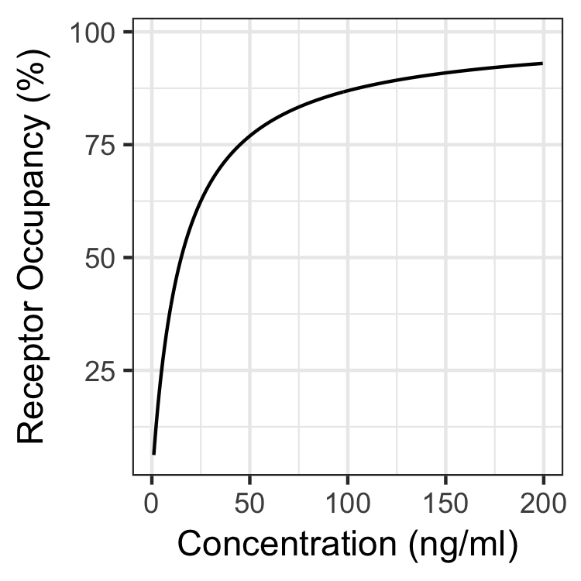
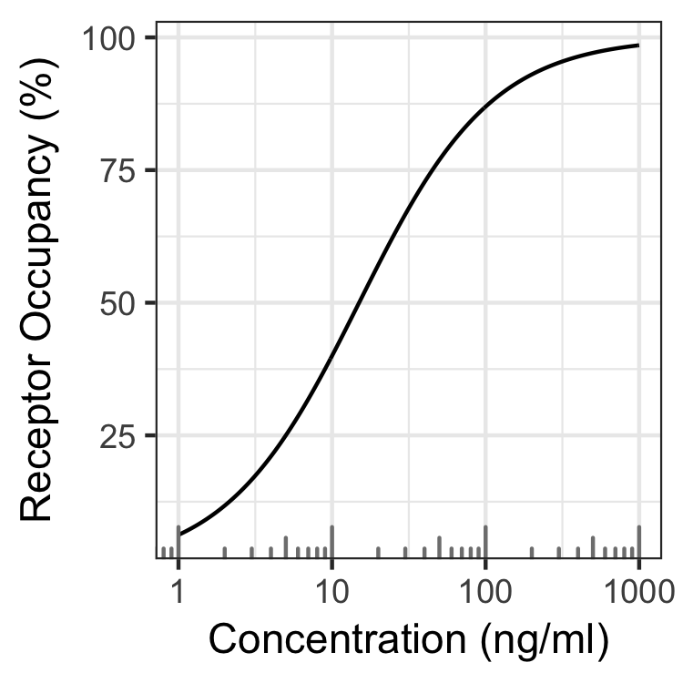
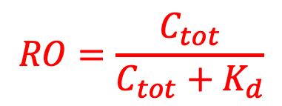
Receptor occupancy in linear and log space
Linear Space
Log Space
$$RO=\frac{C_{tot}}{C_{tot}+K_{d}}$$
Kd = 15 ng/ml

Slide 22
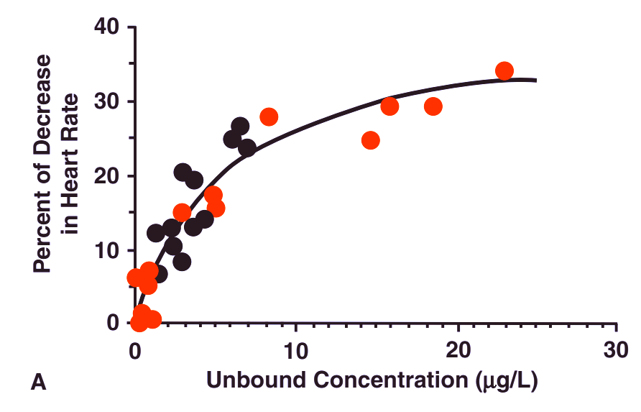
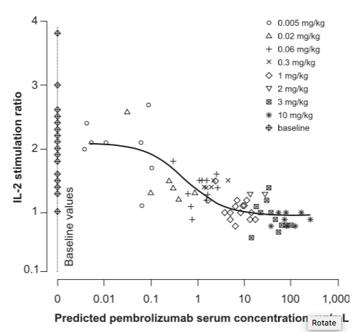
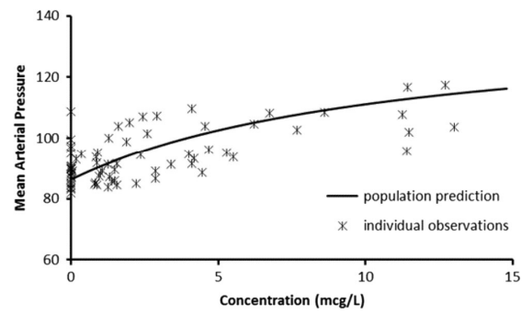
Receptor occupancy type curves describes a lot of data
Propafol effect on heart rate
Keytruda effect on IL-2 stimulation
Phenylepherine effect on blood pressure
Rowland and Tozer, Fig 3-6
Elassaiss‐Schaap, J., et al. "Using model‐based “learn and confirm” to reveal the pharmacokinetics‐pharmacodynamics relationship of pembrolizumab in the KEYNOTE‐001 Trial." CPT: pharmacometrics & systems pharmacology 6.1 (2017): 21-28.
Atkinson, Hartley C., Amanda L. Potts, and Brian J. Anderson. "Potential cardiovascular adverse events when phenylephrine is combined with paracetamol: simulation and narrative review." European journal of clinical pharmacology 71.8 (2015): 931-938.

Slide 23
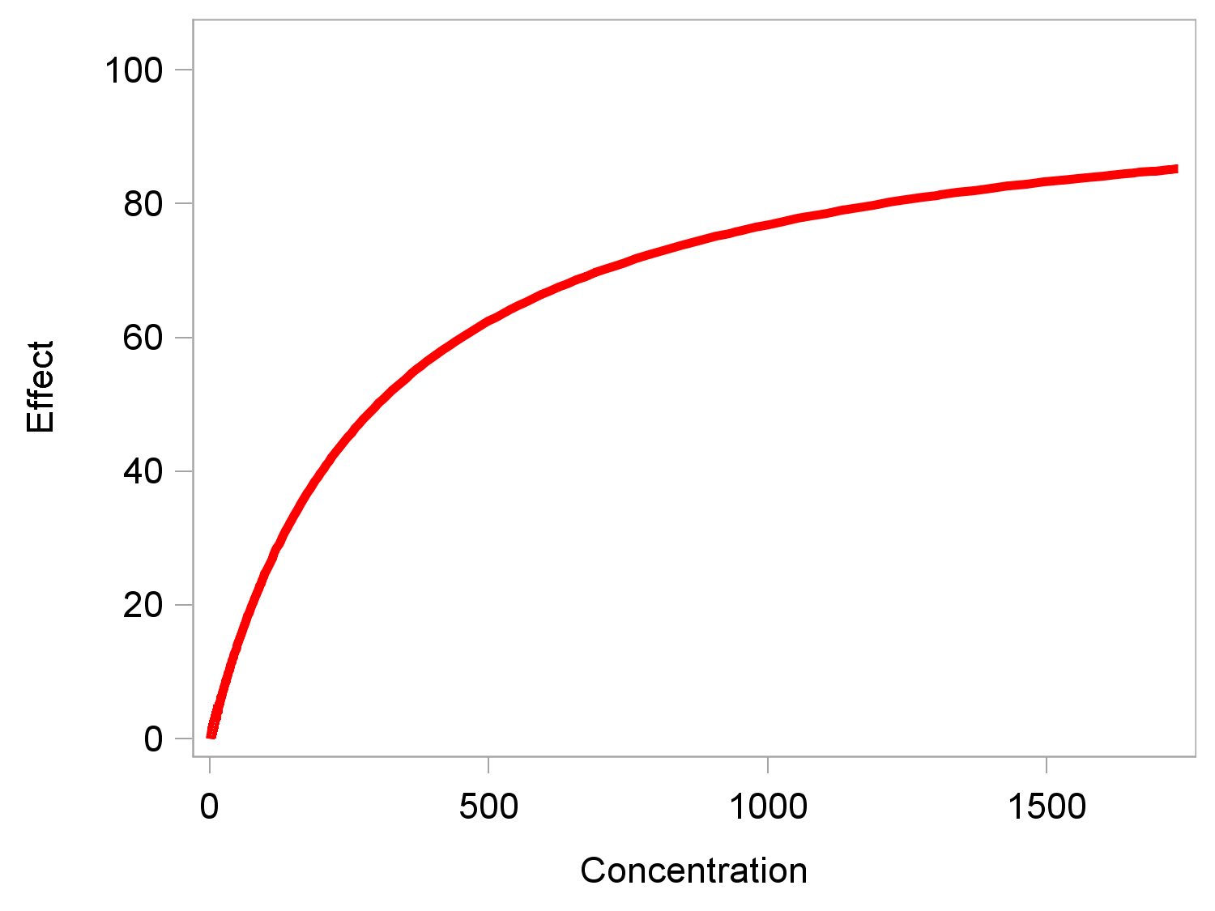
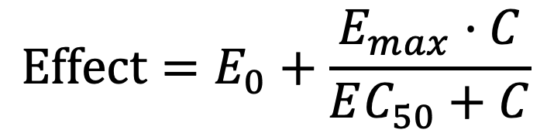
Emax model – positive effect
$$Effect=E_{0}+\frac{E_{max}·C}{EC_{50}+C}$$
E_{max}
Maximal effect
EC₅₀
Concentration that produces 50% of the maximal effect

Slide 24
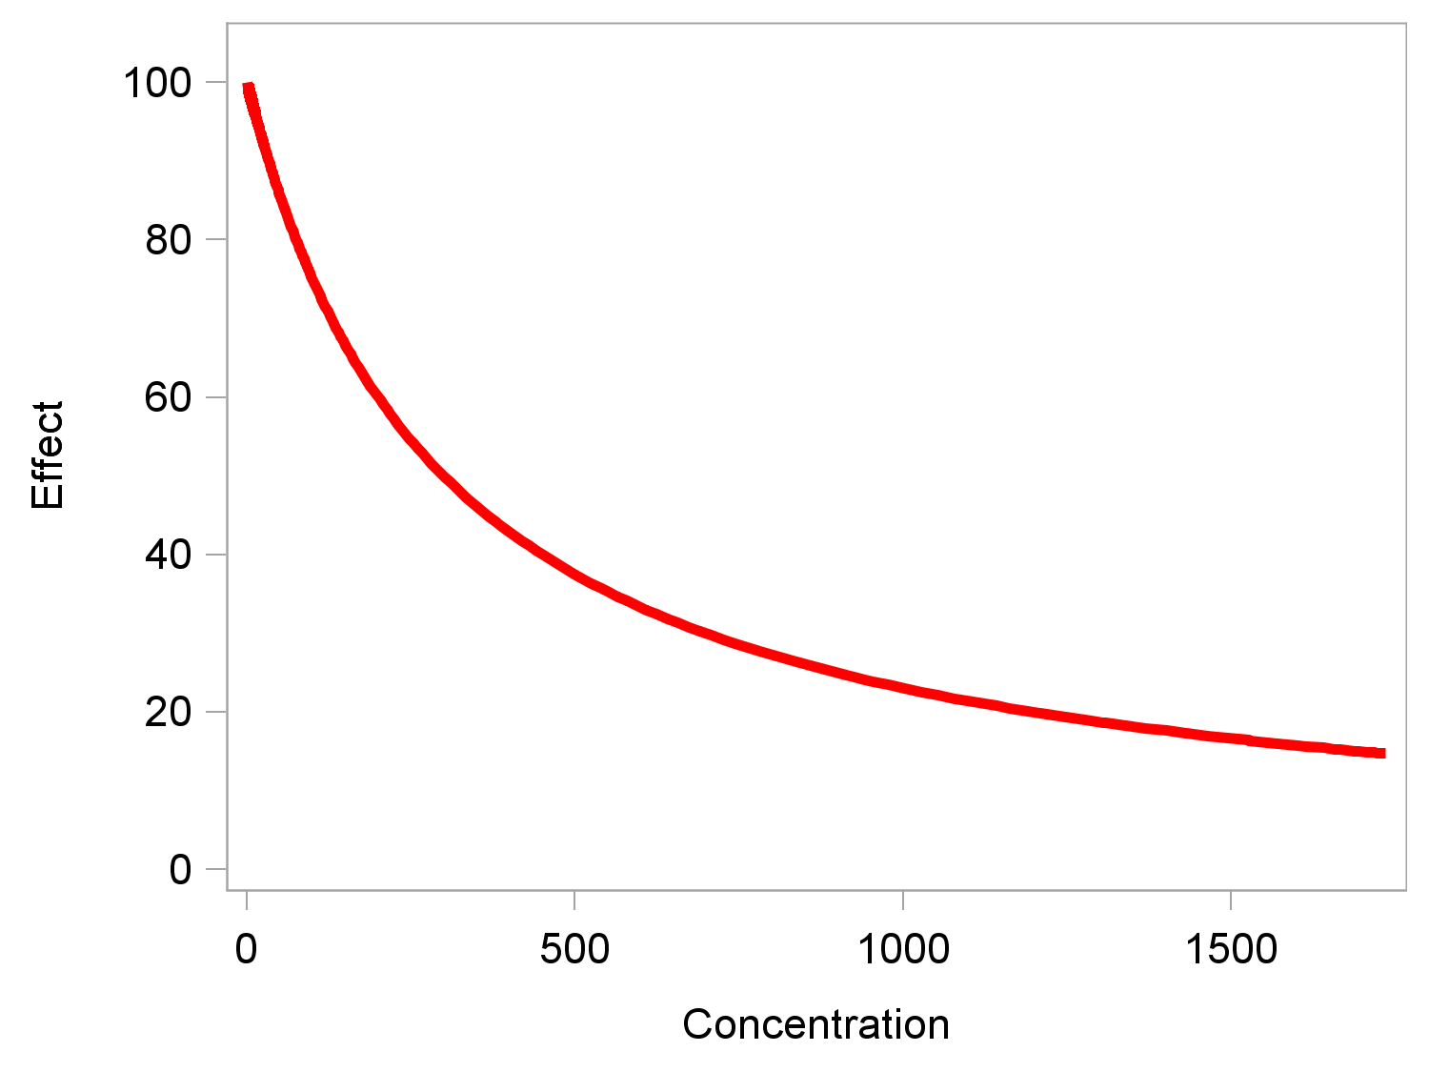
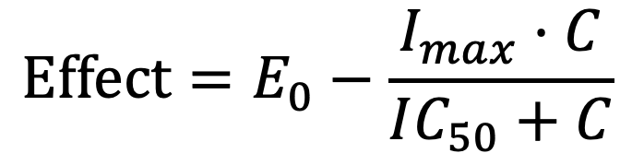
Imax model – negative effect (I = inhibition)
$$Effect=E_{0}−\frac{I_{max}·C}{IC_{50}+C}$$
I_{max}
Maximal
Inhibitory
effect
IC₅₀
Concentration that produces 50% of the maximal inhibitory effect
24

Slide 25
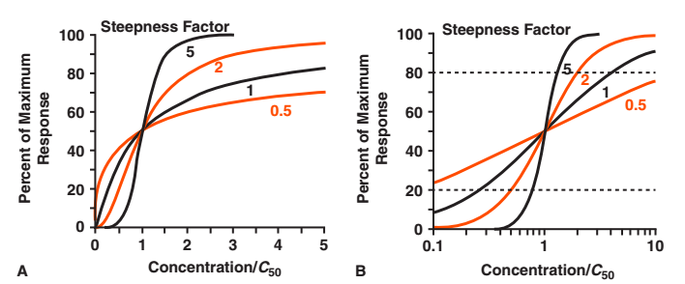
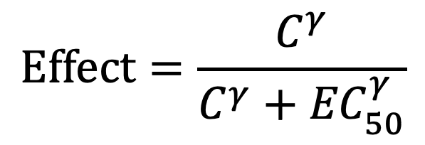
Adding in a steepness factor
$$Effect=\frac{C^{γ}}{C^{γ}+{EC}_{50}^{γ}}$$
- Linear Space
- Log Space
Rowland and Tozer
Notes:
The classical Emax model is for gamma equals to 1
Please note that the x-axis on the LEFT plot is a linear scale → therefore “sigmoidicity” (e.g. between 2 and 5 for the Ketamine data))

Slide 26
Pharmacokinetics and Pharmacodynamics Putting it all together

Slide 27
The “PKPD” pathway of drug effect
Absorbed by intestines into blood
Distribute from blood into tissue
Binds target in tissue
Effects
Oral Dose
Drug Concentration
Measurement
Elimination
from body
Pharmacokinetics (PK):
How body affects drug
Pharmacodynamics (PD):
How drug affects body

Slide 28
Overview – Drug effect/response
Immediate
Delayed
Distributional
Cumulative
Tumor shrinkage
Bone remodeling

Slide 29
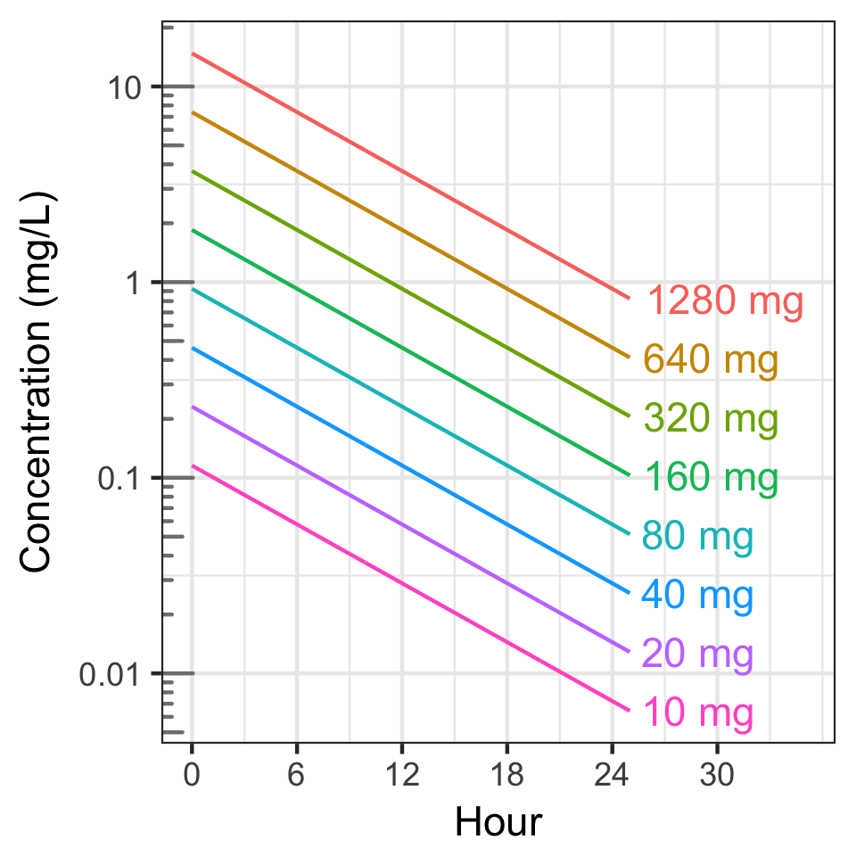
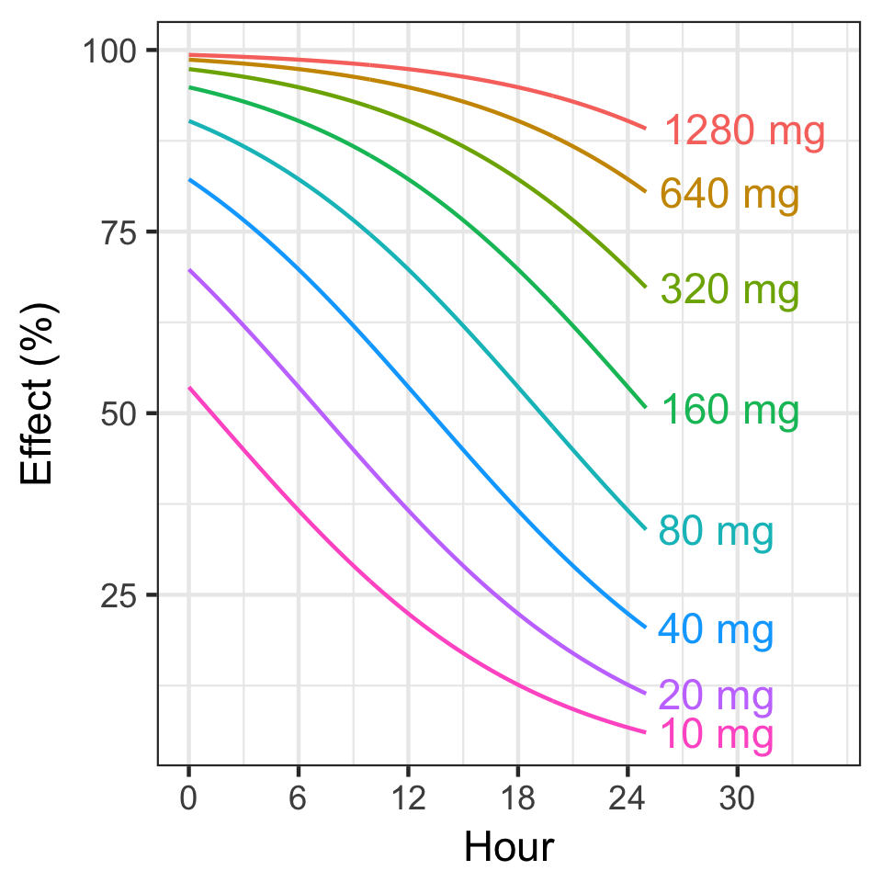
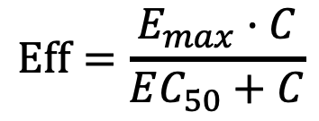
Immediate Effect
Dose
C
$$Eff=\frac{E_{max}·C}{EC_{50}+C}$$
k₁₀
Terminal
Half-Life = 6 h
6h
Doubling dose prolongs effect by 1 half-life

Slide 30
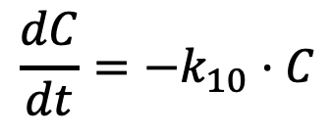
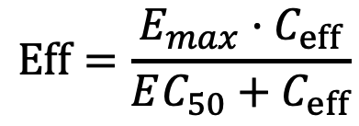
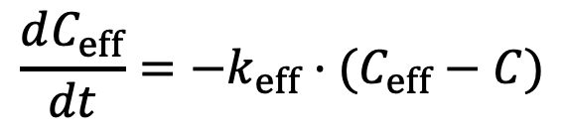
Delayed Effect (distributional)
Measuring drug concentration in tissue is difficult
But it takes time for drug to distribute to tissue
C
k_{eff}
C_{eff}
$$Eff=\frac{E_{max}·C_{eff}}{EC_{50}+C_{eff}}$$
Dose
k₁₀
$$\frac{dC}{dt}=−k_{10}·C$$
Effect compartment is “empirical”
We don’t track the mass of drug moving from central to effect compartment
$$\frac{dC_{eff}}{dt}=−k_{eff}·(C_{eff}−C)$$

Slide 31
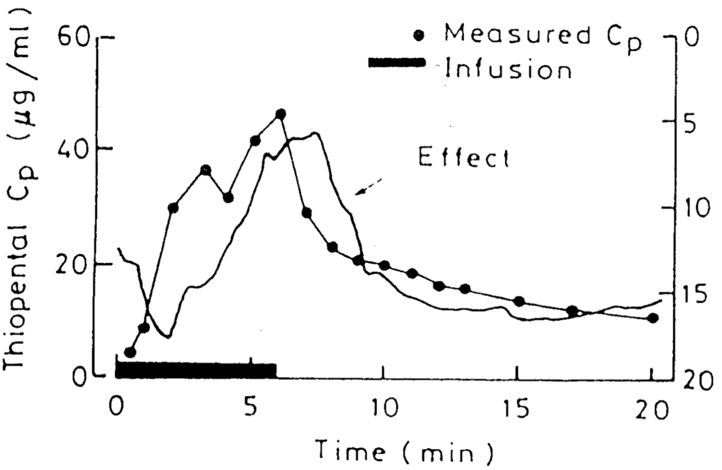
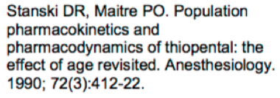
Thiopentone Time Course (anaesthesia drug)
Change in EEG frequency
From Nick Holford

Slide 32
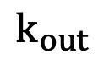
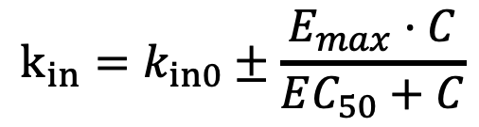
Cumulative Effect (Indirect Response)
Drug impacts the “rate of change” of the effect
Synthesis or degradation of a protein
Growing/shrinking tumor
Could be a stimulatory or inhibitory effect
$$k_{in}=k_{in0}±\frac{E_{max}·C}{EC_{50}+C}$$
Dose
C
E
k₁₀
$$k_{out}$$

Slide 33
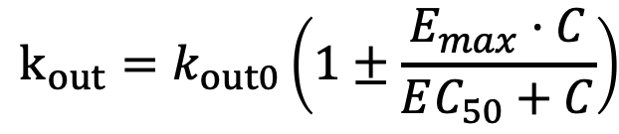
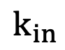
Cumulative Effect (Indirect Response)
Drug impacts the “rate of change” of the effect
Synthesis or degradation of a protein
Growing/shrinking tumor
Could be a stimulatory or inhibitory effect on either the input or the output rate
$$k_{in}$$
Dose
C
E
k₁₀
$$k_{out}=k_{out0}\left(1±\frac{E_{max}·C}{EC_{50}+C}\right)$$

Slide 34
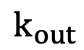
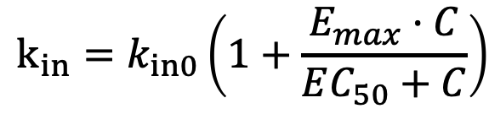


Cumulative Effect Equations (Indirect Response)
$$k_{in}=k_{in0}\left(1+\frac{E_{max}·C}{EC_{50}+C}\right)$$
Dose
C
E
k₁₀
$$k_{out}$$
$$\frac{dC}{dt}=−k_{10}·C$$
$$\frac{dE}{dt}=k_{in0}\left(1+\frac{E_{max}·C}{EC_{50}+C}\right){−k}_{out}E$$

Slide 35





Effect steady states for indircet response equation
$$\frac{dE}{dt}=k_{in0}\left(1+\frac{E_{max}·C}{EC_{50}+C}\right){−k}_{out}E$$
When C=0
At large concentrations,
$$\frac{dE}{dt}=k_{in0}{−k}_{out}E=0$$
$$\frac{dE}{dt}=k_{in0}\left(1+E_{max}\right){−k}_{out}E=0$$
$$E_{0}=\frac{k_{in0}}{k_{out}}$$
$$E_{ss,max}=\frac{k_{in0}(1+E_{max})}{k_{out}}$$

Slide 36




Solution for very large concentration
$$\frac{dE}{dt}≈ k_{in0}\left(1+E_{max}\right){−k}_{out}E$$
$$E_{0}=\frac{k_{in0}}{k_{out}}$$
$$E_{ss,max}=\frac{k_{in0}\left(1+E_{max}\right)}{k_{out}}$$
$$E\left(t\right)=E_{ss,max}+\left(E_{0}−E_{ss,max}\right)e^{−k_{out}t}$$

Slide 37



Cumulative Effect
$$k_{in}=k_{in0}\left(1+\frac{E_{max}·C}{EC_{50}+C}\right)$$
Dose
C
E
k₁₀
$$k_{out}$$
Terminal
Half-Life = 6 h
∞ mg
6h
Doubling dose prolongs effect by 1 half-life

Slide 38


Cumulative Effect
$$k_{in}=k_{in0}\left(1+\frac{E_{max}·C}{EC_{50}+C}\right)$$
Dose
C
E
k₁₀
$$k_{out}$$
$$k_{in0} =100\%/h$$
$$k_{out} =1/h$$
$$E_{max} =4$$
$EC_{50} =0.1 mg/L$
$$E_{0}=\frac{k_{in0}}{k_{out}}=\frac{100\%/h}{1/h}=100\%$$
$k_{in,max} =$ $k_{in0}\left(1+E_{max}\right)$
$$=100\%/h\left(1+4\right)=500\%$$
$$E_{ss,max} =\frac{k_{in,max}}{k_{out}}=\frac{500\%/h}{1/h}=500\%$$

Slide 39



Overview – Drug effect/response
Dose
C
$$Eff=\frac{E_{max}·C}{EC_{50}+C}$$
Immediate
Delayed
Distributional
Cumulative
Tumor shrinkage
Bone remodeling
k₁₀
C
k_{eff}
C_{eff}
Dose
$$Eff=\frac{E_{max}·C_{eff}}{EC_{50}+C_{eff}}$$
k₁₀
$$k_{in}=k_{in0}±\frac{E_{max}·C}{EC_{50}+C}$$
Dose
C
E
k₁₀
k_{out}

Slide 40
More complex models may be needed in some scenarios
PD response changes with time. Examples include:
Tolerance, where first dose has larger effect than subsequent doses.
Cases where PD affects the PK
When a drug shrinks a tumor, but the tumor is also eliminating the drug.
When a drug that affects kidney function is also cleared by the kidney
When patient health generally affects clearance (e.g. checkpoint inhibitors)
Data is rich enough and biology is well enough understood that more mechanism can be built into model

Slide 41
Key Lessons
The Emax model is very useful for describing response
Emax = maximum effect
EC50 = concentration of 50% effect
γ = steepness of effect
Model is inspired by physiology, but parameters do not always have direct physiological meaning
Doubling dose of drug in general prolongs duration of effect by one half-life

Slide 42
Where to learn more
Pharmacology and Pharmacokinetics
Rowland and Tozer, Clinical Pharmacokinetics and Pharmacodynamics (book)
Pharmacometrics (Modeling)
Gabrielsson and Weiner, Pharmacokinetic and Pharmacodynamic Data Analysis (book)
Bonate, Pharmacokinetic-Pharmacodynamic Modeling and Simulation (book)

Slide 43
Bonus Topics

Slide 44

Counterclockwise hysteresis
Reasons:
Biophase
Pro-drug
Indirect effect
Examples:
Anesthetics
Codeine
Cancer chemotherapy
Source: S Kern lecture

Slide 45

Clockwise hysteresis
Reasons:
Tolerance
Learning
Antagonistic metabolite
Examples:
Chronic activator/blocker
Antibiotics
Morphine (?)
Source: S Kern lecture

